Slide 1
Entities
W266
Natural Language Processing

Slide 2
The plan...
Announcements
Information Extraction and Grounding
Named Entity Recognition
Coreference
Relation Extraction

Slide 3
https://course-evaluations.berkeley.edu/berkeley/

Slide 4
Information Extraction

Slide 5
Information Extraction vs. Retrieval
Information Retrieval (IR) - search engine
Goal: satisfy “information need” from query
How: retrieve specific information from corpus
Usually unstructured - string/keyword matching
Information Extraction (IE) - knowledge base
Goal: discover/extract structured information
How: mine lots of information from corpus
Structured information via ML or patterns
(often) Grounded entities

Slide 6
Grounding
Weeks 1-10, low-level NLP: everything ungrounded
Recall Week 1: manipulate text, but no idea what it means
Information Extraction starts (partly) to resolve this
Deal with entities. Can ground to “real world.”
Entity recognition: identify entities (“NER”)
Resolution: ground identified entities
Coreference: recognize things that refer to entities
Relation extraction: describe entities

Slide 7
Caveats / Limitations of IE
IE != full semantic understanding
Only try to understand parts of language: entities and their surroundings
Ex: building a knowledge base - OK to have low per-sentence recall
Can extend further:
Semantic Role Labeling (predicate-argument relations)
Semantic Parsing (build on entity recognition + SRL)
Multi-modal models (text + images)
Grounding of “concepts” (e.g. “red” = , “cat” = 🐱)

Slide 8
Named Entity Recognition (NER)

Slide 9
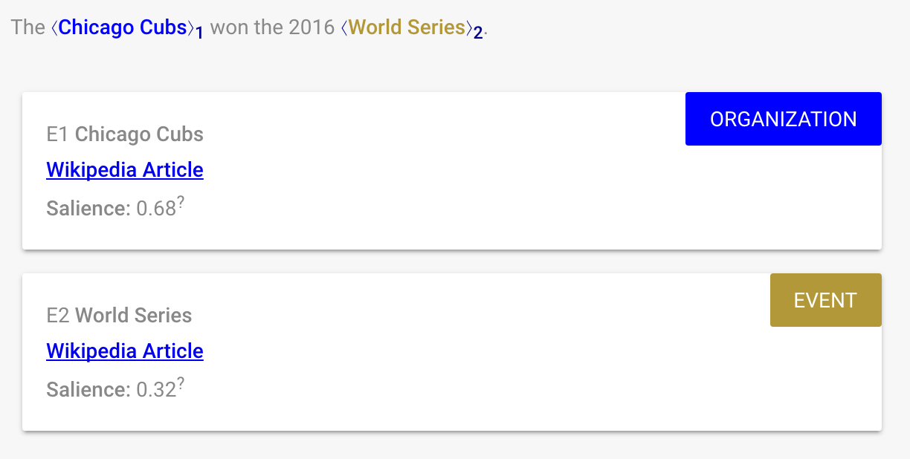
Named Entity Recognition
Base-level IE task. Find things, assign them a type.

Slide 10
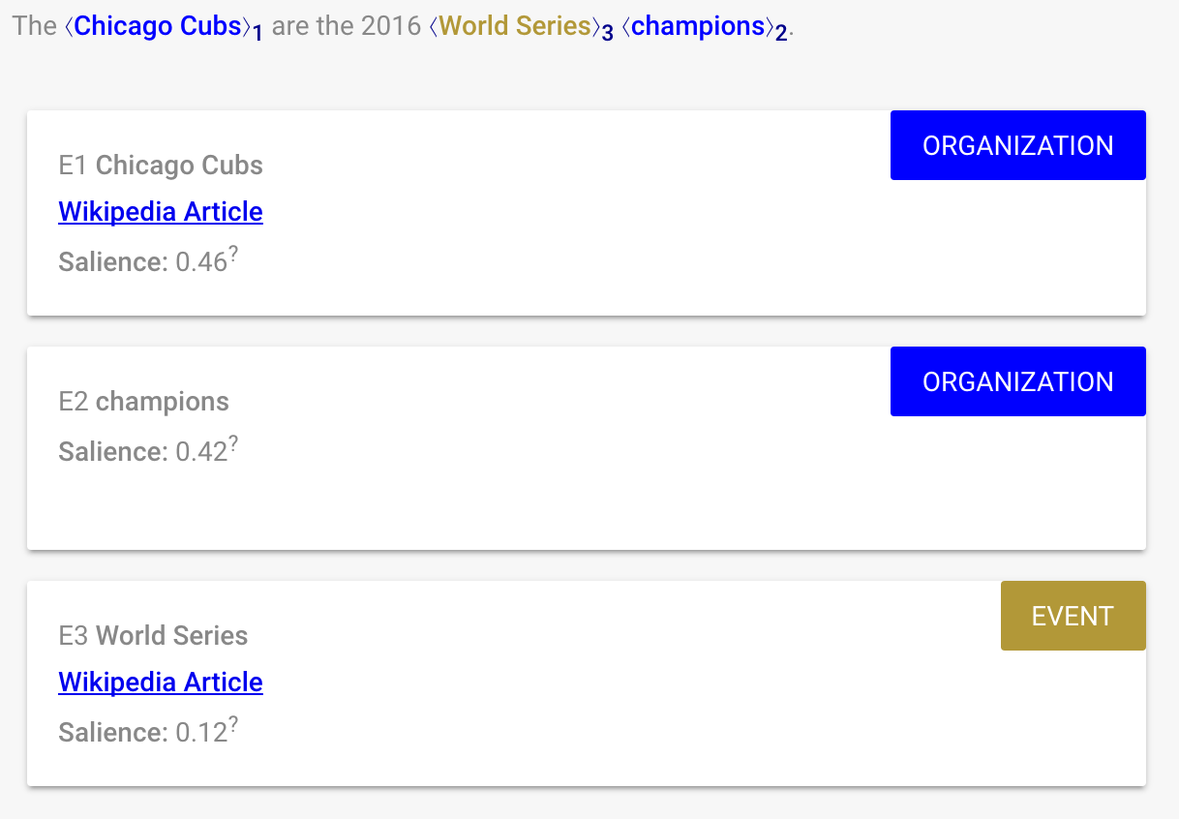
Notes:
Anyone guess what’s happening here? (why is “champions” an organization?)

Slide 11
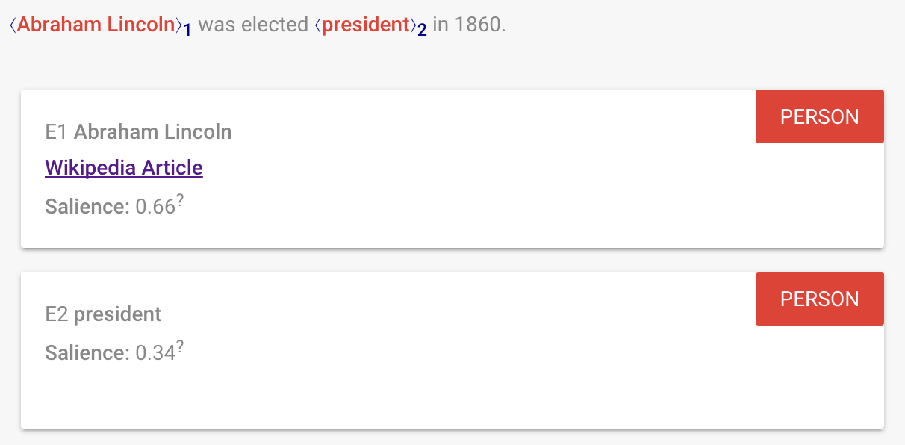
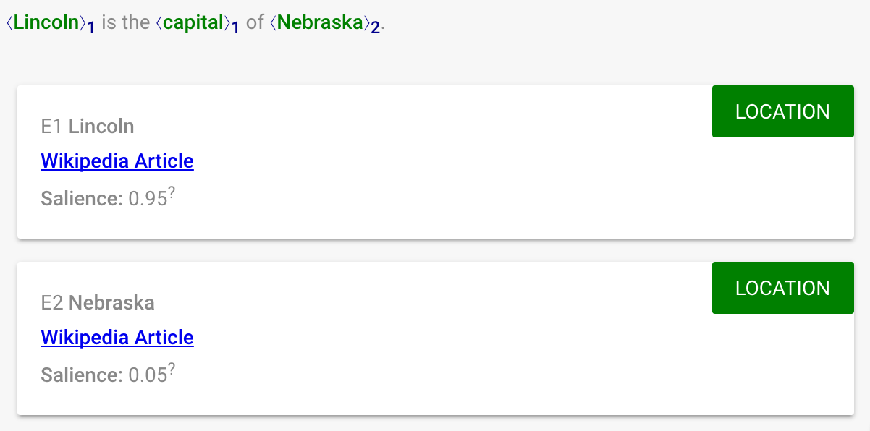
(partial) Sense Disambiguation
Lincoln (person)
Lincoln (place)
POS tagging, parsing: resolve (some) syntactic ambiguity
NER tagging: resolve (some) semantic ambiguity
Notes:
As with most NLP tasks, NER requires resolving (some) ambiguity. Semantic ambiguity somewhat orthogonal to the syntactic ambiguity we saw before.

Slide 12
How to predict?
Sequence tagging task: for each word, assign {PER, LOC, ORG, MISC}
Need BIO encoding to signal endpoints
O | O | B-LOC | I-LOC | B-LOC
train | fares | New | York | Boston
O | O | B-LOC | I-LOC
train | fares | Boston | Massachusetts
Notes:
Classic tagset from CoNLL 2003 shared task: https://www.clips.uantwerpen.be/conll2003/ner/ , although in practical applications you might want something with finer-grained types.

Slide 13
Examples
Sid Reddy lives in New York and Rob stays in Seattle.
Sid->B-PER Reddy->I-PER lives->O in->O New->B-LOC York->I-LOC and->O Rob->B-PER stays->O in->O Seattle->B-LOC.
Her Majesty’s Theatre is in London England and Madison Square Garden is in New York New York.
<Breakout exercise>

Slide 14
How to predict?
Standard sequence-labeling models
Brainstorm: features?
Window model / CNN
Bi-RNN
Conditional random field (CRF)
Notes:
Modern models combine aspects of several of these; common to have biRNN encoder layers and CRF output, or use another decoding scheme such as A* search or a semi-Markov model to predict spans directly.

Slide 15
Coreference Resolution

Slide 16
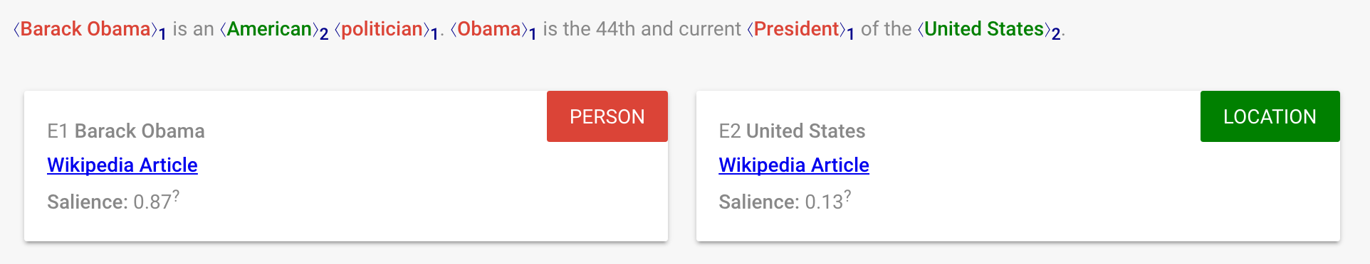
Coreference Resolution
Goal: resolve different mentions of the same entity
Mention: a single “chunk”
Entity: a grounded “thing”
Brainstorm: features?

Slide 17
Coreference Resolution
Hard cases require nuanced semantic understanding
Ex: Winograd schema
“The city councilmen refused the demonstrators a permit because they advocated violence.”
“The city councilmen refused the demonstrators a permit because they feared violence.”
Notes:
See https://en.wikipedia.org/wiki/Winograd_Schema_Challenge

Slide 18
Coreference Resolution
Linguistics note: “anaphora resolution”
Anaphora: expression depends on antecedent
“Sally arrived, but nobody saw her”
Cataphora: expression depends in postcedent
“Before her arrival, nobody saw Sally”
Other types of referents:
Exophora: external context (maybe unresolved)
“He was standing over there”

Slide 19
Anaphora vs. Coreference
Anaphora: The concert is tomorrow. The tickets are on sale today.
Coreference: John ate a bagel. He drank tea.

Slide 20
Machine learning or heuristics?
One very popular heuristic for pronoun coreference resolution is called Hobbs.
Search: Left -> Right within sentence Right -> Left across sentences Right -> Left within sentence Stop when you find a matching noun phrase.
Can use as a ML feature!

Slide 21
Relation Extraction

Slide 22
Relation Extraction
Binary relation: relational triple (e_1, relation, e_2)
(Barack Obama, place-of-birth, Honolulu)
(Barack Obama, height, 6’1”)
Many relations are not binary:
“<company> appointed <person> as <position>”
But often can decompose:
(<person>, employed-by, <company>)
(<person>, has-job-title, <position>)
(<company>, uses-job-title, <position>)

Slide 23
Knowledge Bases
WordNet: low-level semantic relations
Hypernymy: (Giraffe, hyponym-of, animal)
Meronymy: (leg, part-of, chair)
Freebase / Google Knowledge Graph: world knowledge
(Fight Club, /film/film/starring, Brad Pitt)
(Barack Obama, /people/person/date_of_birth, 1961-08-04)
Notes:
https://www.google.com/search?q=when+was+barack+obama+born&oq=when+was+barack+obama+born&aqs=chrome.0.0l6.4355j1j1&sourceid=chrome&ie=UTF-8

Slide 24
Hearst Patterns
Handful of hand-written patterns,
“...X, such as the Y”
“Y, Y, and/or other X”
“X, including Y, Y … and Y”
“X especially Y and/or Y”
Brainstorm: what are we missing?

Slide 25
How to extract?
Basic task:
Find mentions of entities
Extract relations from mention context
“<Barack Obama> is the <president> of the <United States>.”
(Barack Obama, head-of-state, United States)
Formulations:
Rule-based (e.g. Hearst patterns)
Supervised (extract & score)
Semi-supervised (bootstrapping)
Unsupervised (clustering of patterns)

Slide 26
Bootstrapping and Narrative Frames
Relations don’t exist in isolation. Common clusters of co-occurring relations form frames and scripts which we can use to fill in gaps.
Example: “The concert is tomorrow. We’re going see Travis Scott.”
Explicit Relations: (concert, when, tomorrow) (we, will-see, Travis Scott)
Implicit Relations: (we, will-go, concert) (Travis Scott, is-a, musician)

Slide 27

Notes:
Thanks everyone!

Slide 28

Course Evals
Please fill out course evaluations!
Plus and minus, anything we can improve!
https://course-evaluations.berkeley.edu

